Slide 1

AI-Based Learning Resource Finder
REVOLUTIONIZING PROJECT-BASED LEARNING WITH PERSONALIZED RESOURCES
MAYANK KAUSHIK
CSE CORE IV-’I’
2430030310

Slide 2
"Learn Fast, Learn Smart — Let AI Lead the Way."

Slide 3
AGENDA
Our Mission
Introduction and key notes
Target Audience
Challenges
Over-come the Challenges
Future potential and growth
Path to Integration
Conclusion

Slide 4
OUR MISSION
To empower students by providing a smart, AI-driven platform that delivers personalized, high-quality learning resources, enabling them to efficiently and effectively navigate their project-based learning journeys. We aim to simplify the resource discovery process, enhance educational outcomes, and foster independent, self-directed learning at every stage of the project.

Slide 5
WHAT IS THE AI-BASED LEARNING RESOURCE Finder?
The AI-Based Learning Resource Finder is an innovative tool designed to help students, educators, and researchers discover high-quality learning resources tailored to their specific project topics and academic needs. Using artificial intelligence (AI) and natural language processing (NLP), this tool quickly analyzes the input provided by users (such as keywords, topics, or project requirements) and provides a curated list of credible and relevant resources like academic articles, videos, tutorials, and online courses.
An AI-powered tool designed to help students quickly find high-quality learning resources tailored to their project needs.
Focuses on streamlining the search for relevant materials like articles, videos, tutorials, and more.
Adapts to students' evolving project stages, from research to presentation.

Slide 6

KEY NOTES:
Instant Access to Relevant Content: Whether students are in the early brainstorming phase or wrapping up their project, they can find the resources they need, precisely when they need them.
Save Time and Effort: Instead of sifting through pages of irrelevant information, the AI curates a list of resources that are directly related to their topic and project stage.
Boost Confidence: With AI ensuring that all resources are credible and of high quality, students can be confident in the materials they're using for their research and project development.

Slide 7
WHO WILL IT BE HELPFUL FOR?
Students (high school, college, graduate, and independent learners): It saves time by providing tailored, credible resources that match their project topics and stages, ensuring more efficient research and higher-quality work.
Educators & Teachers: Helps teachers recommend relevant resources to students, guiding them through the learning process and enhancing support for project-based assignments.
Educational Institutions: Schools and universities can integrate the tool to streamline resource discovery and improve the overall learning experience for students engaged in research-based learning.
Research Institutions: Researchers can access accurate, credible resources, which accelerates their work by minimizing the time spent searching for references.
This tool is designed to help students, educators, researchers, and educational institutions find high-quality, relevant learning materials, improving efficiency and academic outcomes.

Slide 8






CHALLENGES:
Identifying Key Challenges:
Challenge 1: Ensuring the AI gives relevant and credible resources for diverse topics.
Challenge 2: Designing a user-friendly interface that is simple yet effective for students of all technical backgrounds.
Challenge 3: Dealing with the integration of various educational resources from multiple platforms.
Why These Challenges Matter:
These challenges impact the tool's accuracy, usability, and trustworthiness, which are crucial for student success.

Slide 9


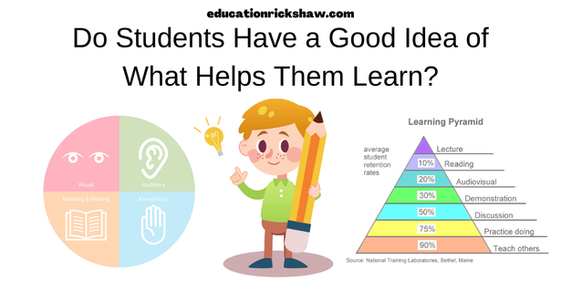

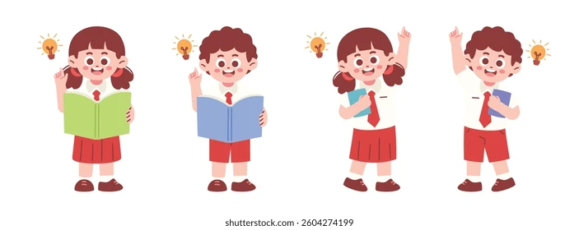
OVER-COME THE CHALLENGES:
Solution for Challenge 1:
"We used advanced machine learning algorithms to ensure that the resources provided are highly relevant, credible, and tailored to each student’s unique needs."
Solution for Challenge 2:
"Our simple UI/UX design focuses on ease of use, with intuitive search options and clear categorization of resources."
Solution for Challenge 3:
"We integrated APIs from trusted educational platforms and used web scraping tools to pull in relevant content from reliable sources."

Slide 10




FUTURE POTENTIAL AND GROWTH:
Growth Opportunities:
Expand Resource Database: Integrating more academic databases and learning platforms (MOOCs, research journals, etc.).
User Customization: Enhancing personalized learning paths for different project types.
Mobile App: Developing a mobile version of the tool for on-the-go access.
Global Reach: Expanding into different languages and educational systems.
Long-Term Impact:
Empower students with tools that make learning more efficient and impactful.

Slide 11
PATH TO INTEGRATION
1-2 months
2-3months
2-3months
1-2 months
1-2 months
Ideation & Conceptualization
Design & Prototyping
Development & AI Integration
Alpha/Beta Testing
Launch & Marketing
Research & Market Analysis: Understand the needs of students and teachers, identify gaps in existing tools, and define the tool's scope.
Feature Definition: Decide on key features like Smart Search, Resource Rating, and Contextual Suggestions.
Project Planning: Develop a timeline and assign team roles. Choose the tech stack (AI, NLP, APIs).
UI/UX Design: Create wireframes and design an intuitive interface that simplifies navigation.
Prototype Development: Build a low-fidelity prototype with core functionalities for internal testing.
User Testing & Feedback: Test the prototype with a small group to gather feedback and improve the design.
Backend Development: Build infrastructure (database, servers, user profiles) and integrate external APIs for resources.
AI & NLP Integration: Implement natural language processing for smart searches and machine learning for resource ranking.
Feature Testing: Test core features (search, ratings, suggestions) for functionality and performance.
Alpha Testing: Conduct initial testing with a select group of users to identify issues and gather feedback.
Beta Testing: Expand testing to a wider audience to fine-tune the tool and ensure scalability.
Bug Fixing & Refining: Address bugs, refine features, and improve the user interface based on feedback.
Pre-Launch Marketing: Build anticipation through promotional materials, social media, and partnerships with educational institutions.
Official Launch: Release the tool publicly with a freemium model or free trial to attract users.
Post-Launch Feedback: Monitor usage, gather feedback, and make immediate improvements.

Slide 12
CONCLUSION
Summary:
"The AI-Based Learning Resource Finder is a tool designed to save time, improve learning outcomes, and help students find the best resources for their project-based assignments."
Call to Action:
"By leveraging AI, we aim to transform the way students approach their projects, helping them learn smarter and more efficiently."
“Join us in revolutionizing access to ideas and emerging technologies.”

Slide 13
Thank you!

